Slide 1
Context
RBC has identified communication and presence skills as an integral part of the IGNITE program. This learning journey aims to equip leaders with the necessary tools to project confidence, adapt to various situations, and foster meaningful connections with their teams and stakeholders.
In the launch program, learners were introduced to the S.A.F.E. model with a focus on harnessing their second circle of presence.
There are four keynote sessions as part of their learning journey. The key topic is communicating with impact by recognizing their own style and flexing to another person’s style.
Deck Notes
Don't be alarmed by the number of slides—it’s structured for clarity, not complexity.
No animations, but slide builds are presented as separate slides for step-by-step progression.
Separate slides allow for additional facilitator notes, making it easier to guide the session effectively.
Designed for flexibility—facilitators can move at their own pace without being locked into animations.
Supports engagement—incremental slide builds help maintain audience focus and avoid overwhelming them with too much information at once.

Slide 2
Session 1: Communicating with Impact
Timing | Content | Objective /Key Message
15 | Opening Welcome Reflections from the Launch The Learning Journey Ahead The S.A.F.E. model and Session Objectives | Create an engaging, positive space and connect the session to participants' growth Establish credibility, build rapport, and set expectations Gather key takeaways, align expectations, and encourage active participation
15 | Recognizing their Communication Styles Energizer: Find Your Style Understanding Business Behavior Styles | Engage participants with an interactive activity to explore their communication preferences Explain the four Business Behavior Styles and how they shape interactions Help participants recognize their dominant style and how it impacts others
20 | Flexing Your Communication Style Why Flexing Matters Breakout Discussion: How to Flex to Other Styles Strategies for Adapting to Other Styles | Define what flexing means and why it is essential for effective collaboration Place learners in breakout rooms so they discuss how to adapt to different styles Gather participant insights through chat engagement and guided discussion.
10 | Wrap-Up Summary Win Learn Change What’s Next | Identify personal Wins, Learns, and Changes from the session Reinforce the most impactful concepts and strategies covered Clarify next steps
60 mins
Materials:
Program pack from the Launch
Notes:
Summary of Activities
Reflections from the Launch – Have participants type their answers/win-learn-change since the launch. “Since the launch, what personal insights or reflections have you had about Executive Presence? How have you noticed it showing up in yourself or others?” Read aloud or summarize a few responses to reinforce key takeaways and themes.
Energizer: Find Your Style. Participants type letters on the chat based on the criteria the facilitator gives:
1st round:
R for Relationship-Oriented or T for Task-Oriented
Participant types R.
2nd round they add the letter to their previous choice with the new criteria the facilitator gives
A for Assertive or E for Easygoing
Participant types, R, A or R, E
The facilitator reveals their communication style
Task-Oriented, Assertive (T, A) – Driver
Relationship-Oriented, Easygoing - Amiable
Task-Oriented, Easygoing - Analytical
Relationship-Oriented, Assertive (R, A) – Expressive
Ask participants to change their names and add the initials. If they are
Driver – D
Amiable – AM
Analytical – AN
Expressive – A
3. Breakout Room – Flexing. Participants are placed in their breakout rooms and they discuss how to flex to their dominant styles.

Slide 3


Communicating with Impact
Jaqueline Dolly
March 2025
Notes:
Welcome
- Introduce yourself and the purpose of the session
- Briefly outline the agenda and learning outcomes

Slide 4

Welcome!

Slide 5

How have you applied what you learned in the way you show up at work?
Notes:
Give space for learners to share their key takeaways.
Ask them to type their answers in the chat to the question: Since the Executive Presence launch, how have you applied what you learned in the way you show up at work?
Read some common themes and highlight examples.

Slide 6
Your Executive Presence Journey
February
Two
April
Launch
One
March
May
June
Three
Four
Executive Presence
Communicating with Impact
Powerful Presenter
Leadership Presence
Business Storytelling
3hrs | F2F | Workshop
1 hr | Virtual | Webinar
1 hr | Virtual | Webinar
1 hr | Virtual | Webinar
1 hr | Virtual | Webinar
Recognize the significance of Executive Presence and its influence on effective leadership
Develop practical strategies to enhance and project Executive Presence with confidence and authenticity
Gain deeper insight into your personal communication style and its impact on others
Recognize different communication preferences and develop the ability to adapt your approach for greater effectiveness and influence
Master proven techniques to strengthen your Executive Presence and create meaningful connections with both in-person and virtual audiences
Manage and sustain your energy and emotional state to consistently project Executive Presence and gravitas
Use storytelling principles to deliver compelling ideas that engage your audience and inspire action
3hrs | F2F | Workshop
1 hr | Virtual | Webinar
1 hr | Virtual | Webinar
1 hr | Virtual | Webinar
1 hr | Virtual | Webinar
Notes:
Remind learners of their learning journey.

Slide 7
Your Executive Presence Journey
February
Two
April
Launch
One
March
May
June
Three
Four
Executive Presence
Communicating with Impact
Powerful Presenter
Leadership Presence
Business Storytelling
3hrs | F2F | Workshop
1 hr | Virtual | Webinar
1 hr | Virtual | Webinar
1 hr | Virtual | Webinar
1 hr | Virtual | Webinar
Recognize the significance of Executive Presence and its influence on effective leadership
Develop practical strategies to enhance and project Executive Presence with confidence and authenticity
Gain deeper insight into your personal communication style and its impact on others
Recognize different communication preferences and develop the ability to adapt your approach for greater effectiveness and influence
Master proven techniques to strengthen your Executive Presence and create meaningful connections with both in-person and virtual audiences
Manage and sustain your energy and emotional state to consistently project Executive Presence and gravitas
Use storytelling principles to deliver compelling ideas that engage your audience and inspire action
3hrs | F2F | Workshop
1 hr | Virtual | Webinar
1 hr | Virtual | Webinar
1 hr | Virtual | Webinar
1 hr | Virtual | Webinar
Notes:
This graphic is to show they’ve completed the launch.

Slide 8
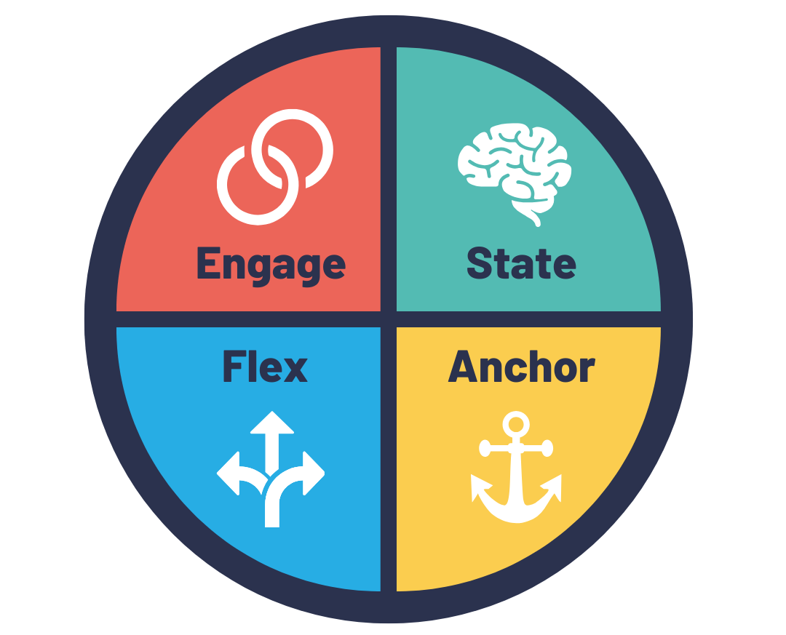
Executive Presence | The SAFE Model
Storytelling Devices
The Three Circles of Presence
Play from a 10
Business Behavior Styles
Eye Contact
Gestures
Voice
Notes:
This is a quick recall of the SAFE model.

Slide 9
Executive Presence | The SAFE Model
Storytelling Devices
The Three Circles of Presence
Play from a 10
Business Behavior Styles
Eye Contact
Gestures
Voice
Notes:
The focus for this session is Business Behavior Styles. For this session, we examine the Flex element through understanding their communication style, how their style affects others, and how to respond and flex to another person’s style.

Slide 10

Objectives
Gain deeper insight into your personal communication style and its impact on others
Recognize different communication preferences and develop the ability to adapt your approach for greater effectiveness and influence
Notes:
Link the session objectives to learners’ WIIFMs.

Slide 11
Business Behaviour Styles
Spontaneous (People)
Dominant
Easy-Going
(Tell)
(Ask)
Controlled (Task)
Notes:
In this activity, participants type letters on the chat based on the criteria you give.
Start with the quadrant.

Slide 12
Business Behaviour Styles
Spontaneous (People)
Dominant
Easy-Going
(Tell)
(Ask)
Controlled (Task)
Notes:
The y-axis describes whether they prefer spontaneity vs control.
Ask them to type S if they prefer spontaneity vs C if they prefer control.

Slide 13
Business Behaviour Styles
Spontaneous (People)
Dominant
Easy-Going
(Tell)
(Ask)
Controlled (Task)
Notes:
In this activity, participants type letters on the chat based on the criteria you give.
Start with this quadrant and give a quick overview.

Slide 14
Business Behaviour Styles
Spontaneous (People)
Expressive
Amiable
Dominant
Easy-Going
(Tell)
Driver
Analytical
(Ask)
Controlled (Task)
Notes:
Talking Points
Discuss the axis.
X axis – How you show up in a room, in a meeting, in an interaction
Easy Going
Relaxed
Slightly backward from the group, step backwards,
Tend to ask questions
Tend to be more of a listener
Tend to be more curious
Dominant
Tend to be the talker
Does a lot of the telling whether it’s the “centre of attention” telling or “giving instructions” kind of telling
Occupying more physical and verbal presentations in a group
Ask people where they are in that particular axis. If they have not completed the online assessment yet, share the assessment with them after explaining the model.
For an in-person session, set up tapes across the room (floor) – representing the axis. Have the participants line up or go to the side of the axis they can relate with/the side revealed by their assessment – one side being labelled as Dominant, another side as Easy-going.
Y axis – Your relationship with things or people or task
Spontaneous
Drawn towards people, social interaction
Dynamic and spontaneous, fluid interaction with people
When you start your day, you prefer to interact with people first than starting with your tasks
Task
Task-driven
When you start your day, you prefer to get on with your task rather than interact with people
When you are in a dialogue with a person, you are more interested in what their product is, and what they can offer instead of knowing the person
Your to-do list gets straight down to tasks and work, instead of prioritizing building relationships
Similar to the previous activity, mark up the tapes on the ground and have people move to the axis where they feel they belong, or the side revealed by their assessment.
Participants might be challenged in determining where they belong. Direct them to their overarching preferences. Have them recall their day or week at work, and how much of their usual work experience reflects that part of the axis.

Slide 15
What are They Like?
Expressive
Spontaneous (People)
Amiable
Competitive, ambitious
Creative, big picture, visionary
Spontaneous
High energy, sensitive
Hates detail
Love to be recognised!
LOVELY!
People-people
Meetings and teamwork
Relationships and getting to know you
Trust and respect
Focus on feelings
Kind & considerate, patient & caring
Dominant
Easy-Going
(Tell)
Yepper”
Time is critical
Straight to the point
No waffle or indecision
Decisive
Outcome-driven
Purposeful and challenging
Likes detail
Process driven
Asks lots of questions
Shows research
Uses lots of evidence
Cautious and deliberate
(Ask)
Driver
Analytical
Controlled (Task)

Slide 16

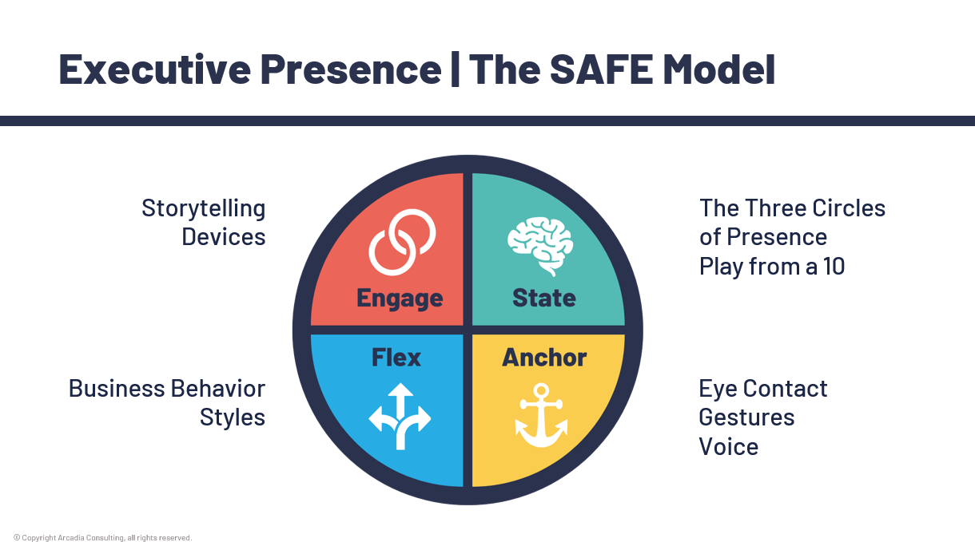
FLEX
Notes:
Relate how flexing is important in the overall Executive Presence model. Strong leaders don’t just rely on one style. They adjust their presence to build rapport, influence effectively, and command attention in a variety of settings.

Slide 17
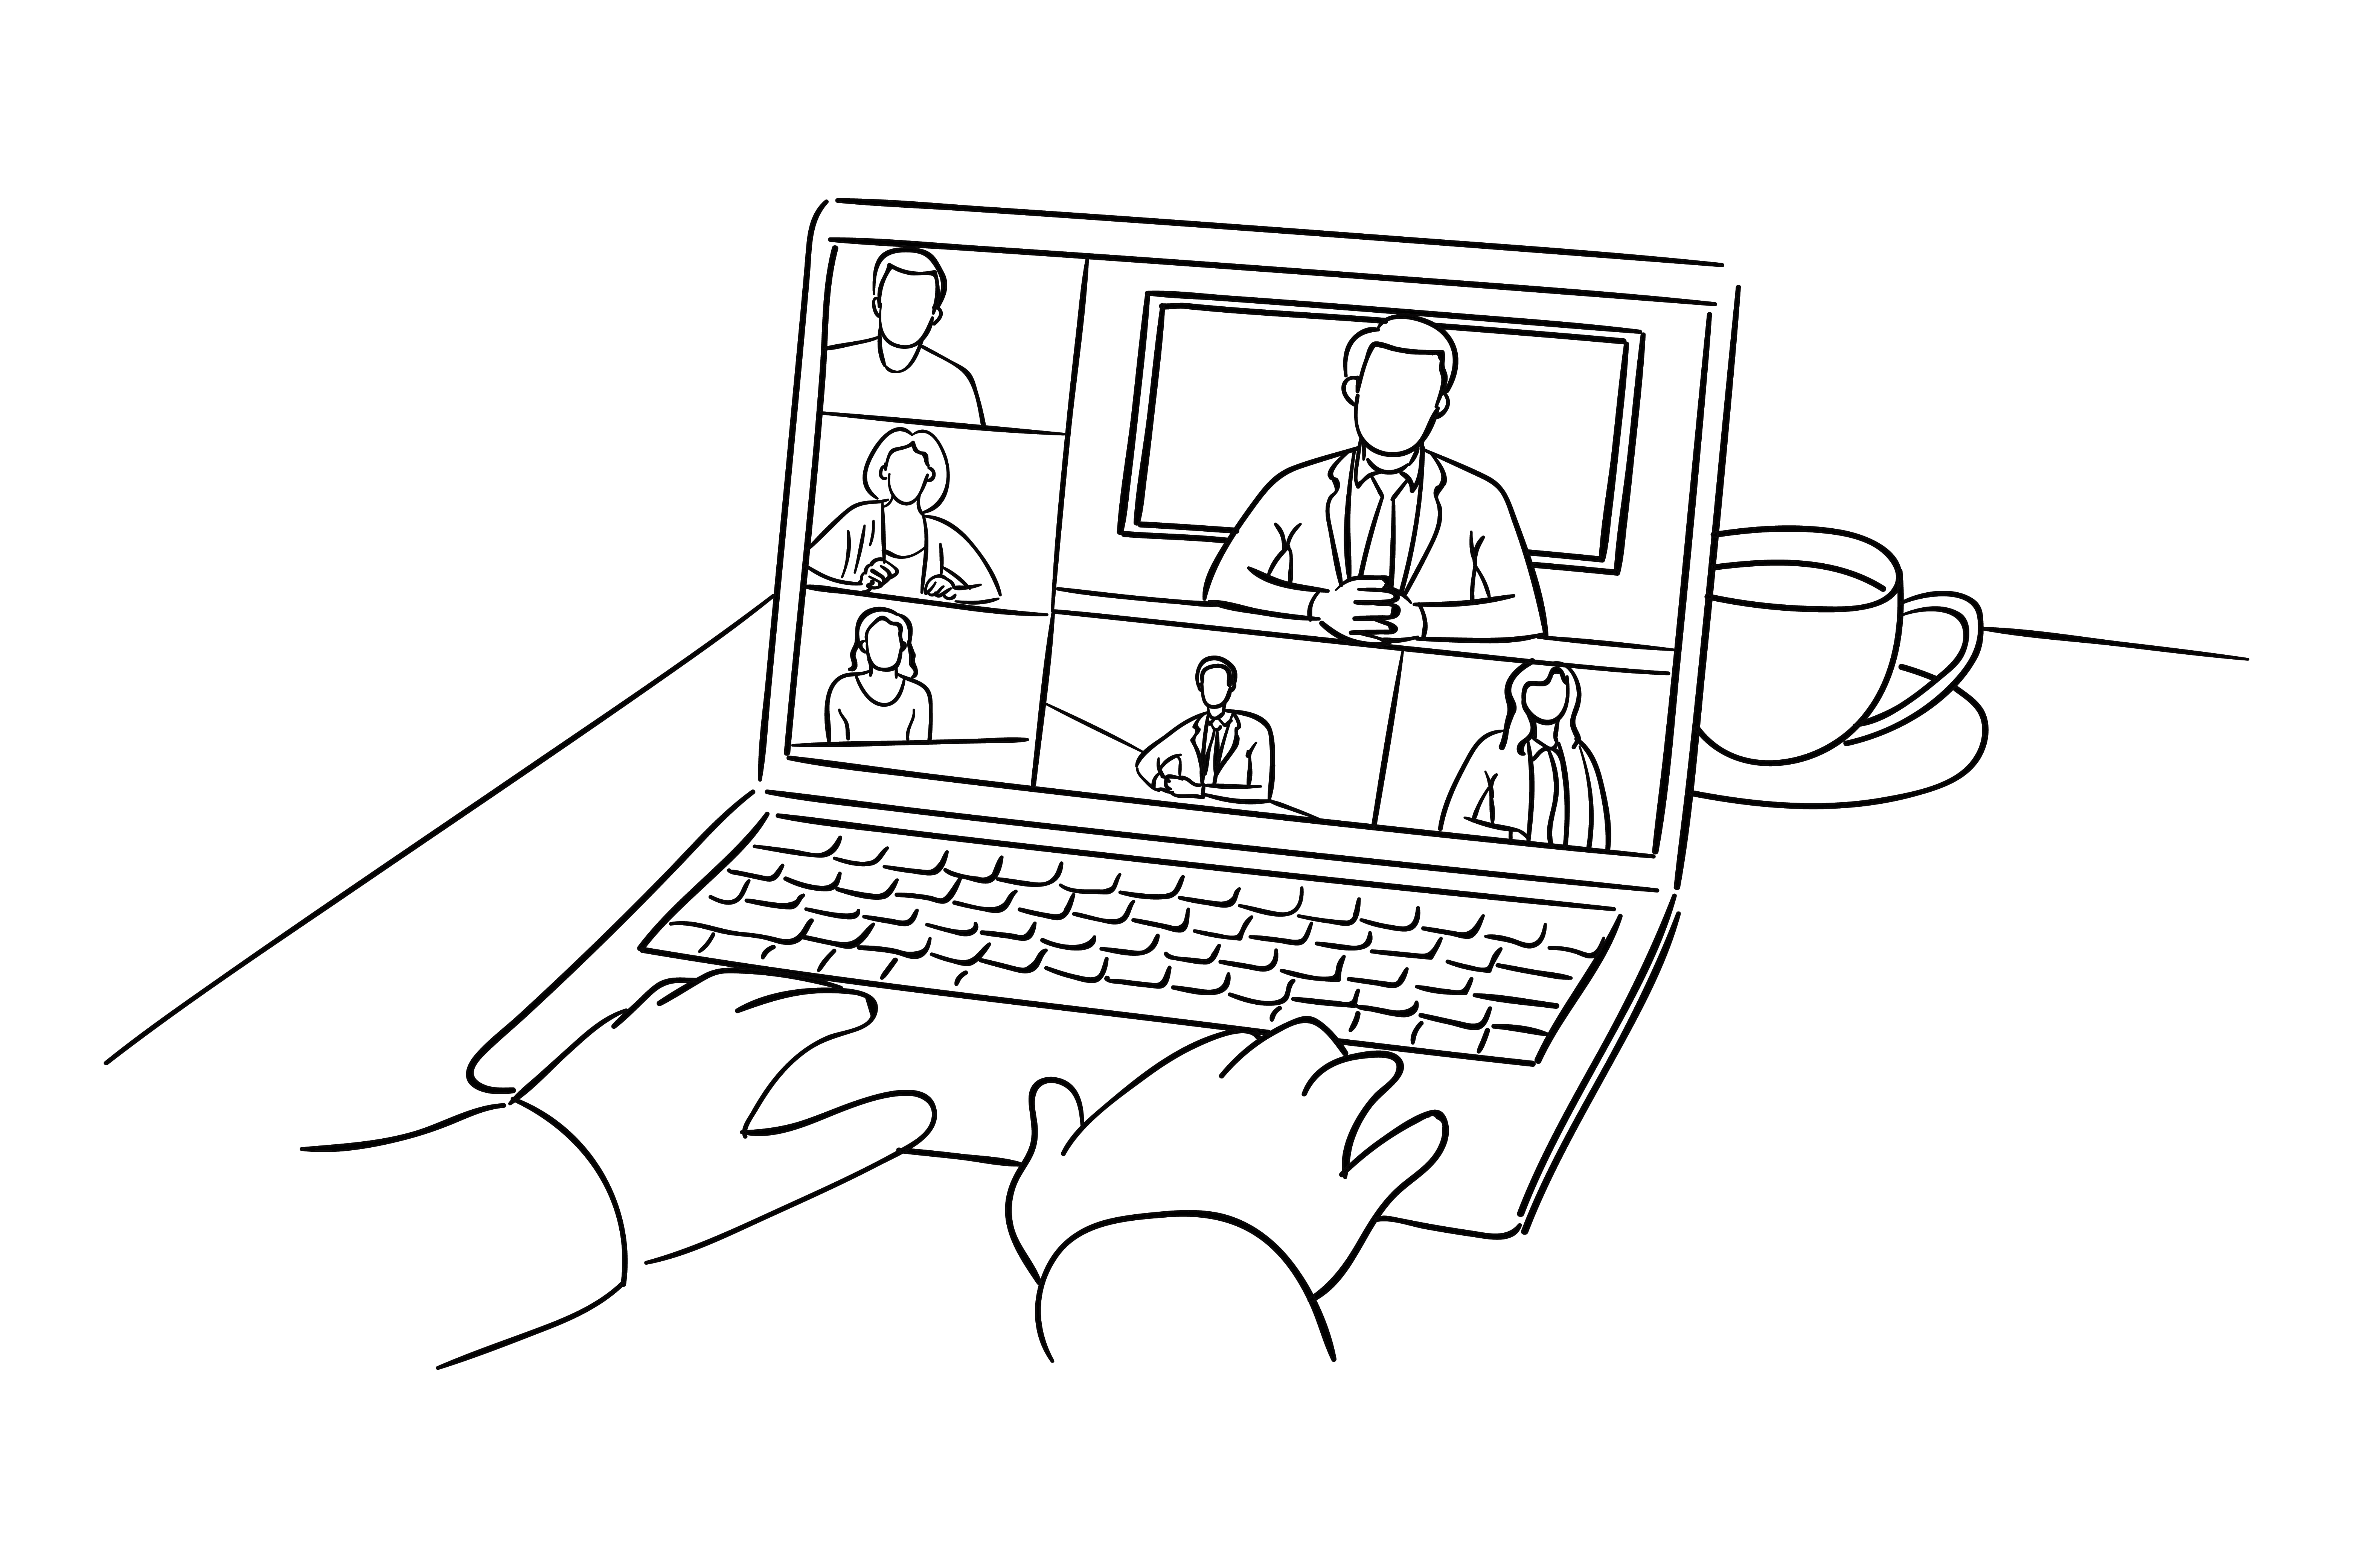
Exploring the Styles
For your dominant style:
How should we approach you to get the best from you?
What don’t you like?
What influences and persuades you?
Notes:
In breakout rooms, have them explore these topics.
The succeeding slides answer these questions.

Slide 18
What are They Like?
Expressive
Spontaneous (People)
Amiable
Competitive, ambitious
Creative, big picture, visionary
Spontaneous
High energy, sensitive
Hates detail
Love to be recognised!
LOVELY!
People-people
Meetings and teamwork
Relationships and getting to know you
Trust and respect
Focus on feelings
Kind & considerate, patient & caring
Dominant
Easy-Going
(Tell)
Yepper”
Time is critical
Straight to the point
No waffle or indecision
Decisive
Outcome-driven
Purposeful and challenging
Likes detail
Process driven
Asks lots of questions
Shows research
Uses lots of evidence
Cautious and deliberate
(Ask)
Driver
Analytical
Controlled (Task)

Slide 19
How should you Communicate with them?
Expressive
Spontaneous (People)
Amiable
High energy
Big Picture focus
Visual
Creative
Bored easily
Shares opinions
Relaxed
Friendly
Doesn’t like too many details
Informal presentation style
Likes consensus
Personable
Dominant
Easy-Going
(Tell)
Strategic
Results focused
Direct / To the Point
Say it once, say it well
Don’t mind conflict
Time short
Structured
Detail focused
Facts and statistics
Wants evidence
Likes options
Takes time to consider
(Ask)
Driver
Analytical
Controlled (Task)

Slide 20
What do you want them to think about you?
They wow me
They have impressive clients
They are excited about the project
They are fun to work with
They pay attention to me
We have a lot in common
They done it before
Everyone seems to like them
They are going to challenge me
They have done it before
They have given me great people
Their assets will save us time
They understand our business
They have thought it through
Their methods are very strong
They will be transparent
They see the risks

Slide 21
What are ‘Rapport-Builders’
Bringing them innovative ideas
Making them look good
Listening and empathizing with them
Having them meet the “Seniors”
Address WIIFM?
Be collaborative
Focus on the chemistry
Minimize change
Show them risks are mitigated
Show them we have done it before
Give them results and quick wins
Have an experienced team
Have assets
Have the courage to challenge
Give them predictability
Show that we understand them
Do what they asked us to do
Recognize risk and how to mitigate it
Have methods & processes, show how
Be rigorous and accurate

Slide 22
What are ‘Rapport-Breakers’?
Didn’t give them the credit
Didn’t pay them/their agenda attention
Didn’t bring them new, innovative ideas
Didn’t listen to them
Didn’t let them feel good
Threatened with too much change
Disrupted harmony
Not collaborative
Pressure
We were too formal
Didn’t focus on/produce results
Hid/surprised them with bad news
Brought the B team, not the A team
Too slow
Undecisive/couldn’t answer questions
Always being sold to
Not transparent
Trying to be right/prove THEM wrong
Being seen as risky and impulsive
Not business-like

Slide 23
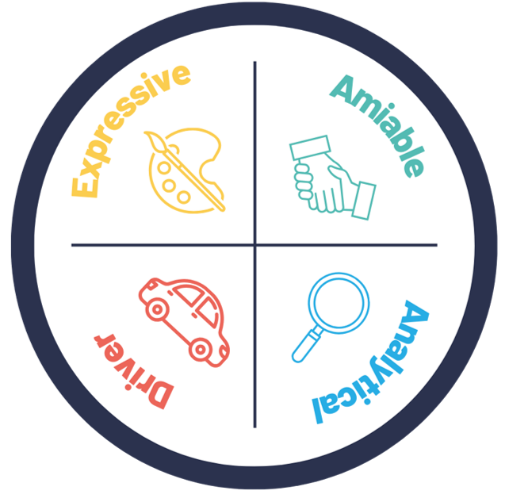
FLEX | Business Behavior Styles

Slide 24
Win Learn Change
Win
Learn
Change
Things that went well, that you’re pleased with
Things that didn‘t work as hoped, yet, provided learning
Things to change for next time – action steps
Strengths
Insights
Areas for Growth
Notes:
Write down their win, learn, change.
J

Slide 25


Your Win?
Your Learn?
Your Change?
Notes:
Write down their win, learn, change.
J

Slide 26
What’s Next?
February
Two
April
Launch
One
March
May
June
Three
Four
Executive Presence
Communicating with Impact
Powerful Presenter
Leadership Presence
Business Storytelling
3hrs | F2F | Workshop
1 hr | Virtual | Webinar
1 hr | Virtual | Webinar
1 hr | Virtual | Webinar
1 hr | Virtual | Webinar
Recognize the significance of Executive Presence and its influence on effective leadership
Develop practical strategies to enhance and project Executive Presence with confidence and authenticity
Gain deeper insight into your personal communication style and its impact on others
Recognize different communication preferences and develop the ability to adapt your approach for greater effectiveness and influence
Master proven techniques to strengthen your Executive Presence and create meaningful connections with both in-person and virtual audiences
Manage and sustain your energy and emotional state to consistently project Executive Presence and gravitas
Use storytelling principles to deliver compelling ideas that engage your audience and inspire action
3hrs | F2F | Workshop
1 hr | Virtual | Webinar
1 hr | Virtual | Webinar
1 hr | Virtual | Webinar
1 hr | Virtual | Webinar
Notes:
Keynote Sessions: Elevating Leadership Presence: Following the launch, participants will progress through four 60-minute modules, each designed to build on their executive presence:
Communicating with Impact – Understanding personal communication tendencies and adapting strategies to connect and engage.
Powerful Presenter – Applying proven techniques to command presence in both in-person and virtual settings.
Leadership Presence – Regulating energy and emotional state to ensure a consistent, credible, and authoritative presence.
Business Storytelling – Equipping participants with storytelling techniques to convey ideas with clarity and impact, ensuring messages resonate and drive action.

Slide 27
Before Our Next Session
Think About One of Your Community Partners: Reflect on how you currently engage with them and the impact of your communication style.
Capture Your Key Takeaways: Note your Wins, Learns and Changes
Prepare to Share: Be ready to share personal insights and reflections in the next session

Slide 28
Thank You!
Please take a few minutes to fill out the following survey using the following details
Facilitator:
Session Name:

